Slide 1
SS ZG653: Software Architecture Lecture 8: Introduction to Patterns
Instructor: Prof. Santonu Sarkar
February 10, 2015

Slide 2

Christopher Alexander
The Timeless Way of Building is a 1979 book that ties life and architecture together
Much of SW Architecture derives from it
A Pattern Language: Towns, Buildings, Construction is a 1977 book on architecture
Source: http://en.wikipedia.org/wiki/Christopher_Alexander

Slide 3
What is a (Architecture) Pattern
A set of components (or subsystems), their responsibilities, interactions, and the way they collaborate
Constraints or rules that decide the interaction
To solve a recurring architectural problem in a generic way
Synonymous to architecture style
Buschmann, F. et al, Pattern Oriented Software Architecture – Volume1, Wiley, 1996

Slide 4
Properties of Patterns
Addresses a recurring design problem that arises in specific design situations and presents a solution to it
Document existing, well-proven design experience
Identify and Specify abstractions at the high(est) level
Provide a common vocabulary and understanding of design principles
Helps to build complex systems
Manage software complexity

Slide 5
A note on Design Principles
A set of guidelines that helps to get a good design
Robert Martin’s book on Agile Software Development says
Avoid Rigidity (hard to change)
Avoid Fragility (whenever I change it breaks)
Avoid Immobility (can’t be reused)

Slide 6
OO Design Principles
Open close
Open to extension and close for modification
Template and strategy pattern
Dependency inversion
Decouple two module dependencies (A→ B)
A holds the interface of B. Implementer of B implments the interface.
Adapter pattern
Liskov’s Substitution
Superclass can be replaced by subclass
Interface Segregation
Don’t pollute an interface. Define for a specific purpose
Single responsibility
One class only one task

Slide 7
Pattern – Three-part Schema
Pattern
Context A situation giving rise to a problem
Problem The recurring problem arising in that context
Solution A proven solution of the problem

Slide 8
Context
A scenario or situation where design problem arises
Describe situations in which the problem occurs
Ideally the scenario should be generic, but it may not always be possible
Give a list all known situations
Example
Developing Messaging solution for a mobile phone
Developing software for a Man Machine Interface
Context
Pattern
Problem
Solution

Slide 9
Problem
Starts with a generic problem statement; captures the central theme
Completed by forces; aspect of the problem that should be considered when solving it
It is a Requirement
It can be a Constraint
It can be a Desirable property
Forces complement or contradict
Example
Ease of modifying the User Interface (Personalisation)
Context
Pattern
Problem
Solution

Slide 10
Solution
Configuration to balance forces
Structure with components and relationships
Run-time behavior
Structure: Addresses static part of the solution
Run-time: Behavior while running – addresses the dynamic part
Example
Building blocks for the application
Specific inputs events and their processing
Context
Pattern
Problem
Solution

Slide 11
Reference Model
Architecture Style/Pattern
Operational Platform and Infrastructure Pattern
Design Pattern
Idioms
Programming language level best practices
software-centric solution to implement the application logic, data and the interaction. The solutions include (but not limited to) package structure, analysis patterns for data modeling
GoF, Fowler’s analysis pattern
A topology of nodes where the functional blocks will be deployed at runtime
A topology of hardware devices
Multi-tier pattern, IBM runtime patterns, availability patterns
A set of components (or subsystems), their responsibilities, interactions, and the way they collaborate
address one or more quality concerns
An ideal solution for a domain, comprising of only functional elements without any technology or operational platform
NGOSS framework in Telecom
Open financial services architecture based on the use of intelligent mobile devices,” Electronic Commerce Research and Applications, 2008.
Abstract
Implementation

Slide 12
Pattern System
A pattern system for software architecture is a collection of patterns for software architecture, together with guidelines for their implementation, combination and practical use of software development

Slide 13
Pattern System
Support the development of high-quality software systems; Functional and non-functional requirements
It should comprise a sufficient base of patterns
It should describe all its patterns uniformly
It should expose the various relationships between patterns
It should organize its constituent patterns
It should support the construction of software systems
It should support its own evolution

Slide 14
Pattern Classification
It should be simple and easy to learn
It should consist of only a few classification criteria
Each classification criterion should reflect natural properties of patterns
It should provide a ‘roadmap’
The schema should be open to integration of new patterns

Slide 15
Problem Categories
Category | Description
Mud to Structure | Includes patterns that support suitable decomposition of an overall system task into cooperating subtasks
Distributed Systems | Includes patterns that provide infrastructures for systems that have components located in different processes or in several subsystems and components
Interactive Systems | Includes patterns that help to structure human-computer interaction
Adaptable Systems | Includes patterns that provide infrastructures for the extension and adaptation of application in response to evolving and changing functional requirements
Structural Decomposition | Includes patterns that support a suitable decomposition of subsystems and complex components into cooperating parts
Organization of Work | Includes patterns that define how components collaborate to provide a complex service

Slide 16
Problem Categories
Category | Description
Creation | Includes patterns that help with instantiating objects and recursive object structures
Service Variation | Comprises patterns that support changing the behavior of an object or component
Service Extension | Includes patterns that help to add new services to an object or object structure dynamically
Adaptation | Provides patterns that help with interface and data conversion
Access Control | Includes patterns that guard and control access to services or components
Management | Includes patterns for handling homogenous collections of objects, services and components in their entirety
Communication | Includes patterns that help organize communication between components
Resource handling | Includes patterns that help manage shared components and objects

Slide 17
Pattern Classification
 | Architectural Patterns | Design Patterns | Idioms
Mud to Structure | Layers, Pipes and Filters, Blackboard
Distributed Systems | Broker, Pipes and Filters, Microkernel
Interactive Systems | MVC, PAC
Adaptable Systems | Microkernel, Reflection
Creation |  | Abstract Factory, Prototype, Builder | Singleton, Factory Method
Structural Decomposition |  | Whole-Part, Composite
Organisation of work |  | Master-Slave, Chain of Responsibility, Command, Mediator
Access Control |  | Proxy, Façade, Iterator
Service Variation |  | Bridge, Strategy, State | Template method
Service Extension |  | Decorator, Visitor
Management |  | Command Processor, View Handler, Memento
Adaptation |  | Adapter
Communication |  | Publisher-subscriber, Forwarder-Receiver, Client-Dispatcher-Server
Resource Handling |  | Flyweight | Counted Pointer

Slide 18

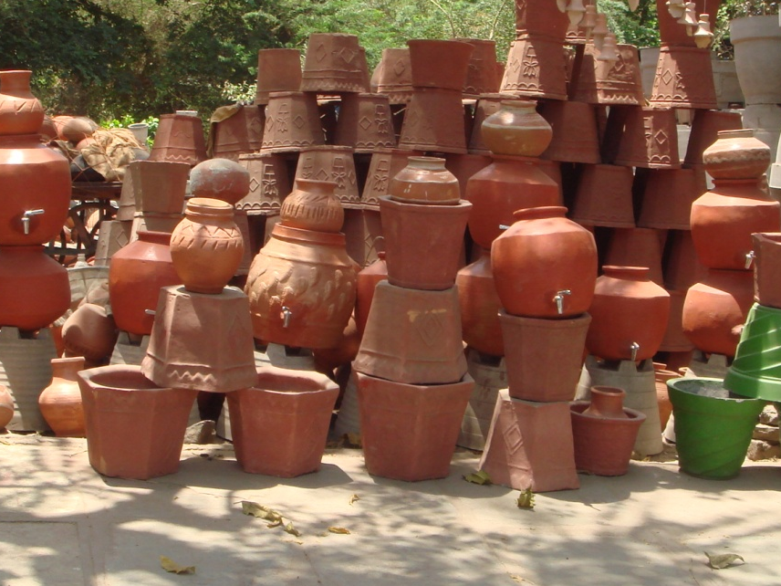
Mud to Structure

Slide 19
Mud to Structure
Before we start a new system, we collect requirement from customer → transform those into specifications
Requirements → Architecture (Optimistic View)
“Ball of mud” is the realization
Cutting the ball along only one aspect (like along lines visible in the application domain may not be of help)
Need to consider functional and non-funcational attributes

Slide 20
Architectural Patterns
Layers
Pipes and Filters
Blackboard
Mud to Structure
Broker
Distributed Systems
Model-View-Controller
Presentation-Abstraction-Control
Interactive Systems
Microkernel
Reflection
Adaptable Systems

Slide 21
Layers
Mud to Structure

Slide 22

Petstore example again…
Suppose that the store should provide the capability for a user to
Browse the catalog of products
Select a product and put it in shopping cart
Product is stored in a Table
Name | Category | Age | Price
Labrador | Dog | 1 | 3500
Pug | Dog | 1.5 | 1500
Goldfish1 | Fish | 0.5 | 50

Slide 23

When you implement, it will look like Flipkart or Amazon…
Shopping cart
When application runs, it displays products based on category
User Selects a product and puts it shopping cart
product
Many users accessing the application
product
Category
Application logic is deciding product price, managing users
Product database

Slide 24
What you need at a minimum?
Three sets of classes
One set manages display of products, ease of selection, navigation
Another set manages the product management, pricing
Another set manages the database access
UI Layer classes
Business Layer classes
Database Layer classes

Slide 25
Layers Architectural Pattern
Helps to structure application that can be decomposed into groups of subtasks in which each group of subtasks is at a particular level of abstraction

Slide 26
Layers
Implementing protocols
Conceptually different issues split into separate, interacting layers
Functionality decomposed into layers; helps replace layer(s) with better or different implementation

Slide 27
Layers – 3 part schema
Context | A large system that requires decomposition
Problem | Mix of low- and high-level issues, where high-level operations rely on low-level ones A typical pattern of communication flow consists of requests moving from high level to low level, and answers to requests, incoming data and notification about events traveling in the opposite direction
Forces | Code changes should not ripple through the system Stable interfaces; standardization Exchangeable parts Grouping of responsibilities for better understandability and maintainability
Solution | Structure the system into appropriate number of layers

Slide 28
OSI 7-Layer Model
Layer 7
Provides miscellaneous protocols for common activities
Application
Layer 6
Structures information and attaches semantics
Presentation
Session
Layer 5
Provides dialog control and synchronization facilities
Transport
Breaks messages into packets and guarantees delivery
Layer 4
Network
Selects route from sender to receiver
Layer 3
Data Link
Detects and corrects errors in bit sequences
Layer 2
Physical
Layer 1
Transmits bits: velocity, bit-code, connection etc.

Slide 29
Layers
Client
Layer N
Component-N.1
Component-N.2
Component-N.3
Services of Layer J are only used by Layer J+1
No further direct dependencies between layers
Each layer may contain many components
Layer N-1
Component-(N-1).1
Component-(N-1).2
Component-(N-1).3
Layer 1
Component-1.1
Component-1.2
Component-1.3

Slide 30
Dynamics
Client receives
Client calls
Layer N
Layer N
cannot carry out the request completely on its own, it calls layer N-1
Reporting continues till the top
Layer N-1
Layer N-1
Request passing continues till Layer 1 fulfills the request
Device driver gets notification
Reports to the higher layer
Layer 1
Layer 1
Scenario - I
Scenario - II

Slide 31
Dynamics
Client calls
Layer N
Layer N
cannot carry out the request completely on its own, it calls layer below BUT….
Middle layer understands that it is a repeat request and sends the notification
Request passing does NOT continue till Layer 1.
Some Intermediate layer fulfills the req.
Layer N-k
Layer N-k
In a network protocol, lowest layer intercepts a request
Reports to the higher layer
Layer 1
Layer 1
Scenario – IV (In network protocol design, intermediate layer responds based on a notification
Scenario – III (layer of caching, where
An intermediate layer returns the data)

Slide 32
Dynamics
Scenario V
Involves two stacks communication with each other
Request received
Send request
Layer N
Layer N
Response received
Response sent
Layer N-1
Layer N-1
Layer 1
Layer 1
Send request goes through physical layer
Response message comes back through physical layer

Slide 33
Implementation Guideline
Define the abstraction criteria
Determine the numbers of layers based on abstraction criteria
Specify the communication between adjacent layers
Name the layers and assign tasks to each of them
Specify the services
Decouple adjacent layers
Iterate and refine
Design error handling strategy
Specify an interface for each layer
Structure individual layers

Slide 34
Define abstraction criteria
Level of abstractions define the layers. Heuristics can be
Most generic components are in lowest layer whereas the domain-specific components are in top layer
More stable components (which hardly undergoes change) are in lower layer. Use degree of stability to decide layers
Distance from hardware
User-visible elements
Specific Application Modules
Common Service Levels
OS Interface Level
Hardware

Slide 35
Determine the no. of abstraction levels
Typically each abstraction level is one layer
Map the abstraction levels to layers
Use mechanisms to keep number of layers to optimum number (say 3 layers for a typical self-service based application)
Too Few Layers → Can Result in Poor Structure
Too Many Layers → Impose Unnecessary Overhead

Slide 36
Complete Layer specification
Name the layer and assign tasks
Highest layers are system functionality perceived by the user
Lower layers are helpers
In bottom up approach – create generic tasks at the lowest level- sort of infrastructure
Requires experience to achieve this
B) Specify the services
Strict separation of layers
No component should spread over two layers
Inverted pyramid of use

Slide 37
Construct Each Layer
Specify layer interface
Use a black box approach
Layer N treats Layer N-1 as a black box
Structure each layer
Identify components inside each layer
Bridge or strategy pattern can help
Supports multiple implementations of services provided by a layer
Supports Dynamic exchange of algorithms used by a user

Slide 38
Inter layer communication
Identify communication mechanism
Push: upper layer invokes a service of lower one
Pull mechanism
Layer decoupling
Lower layer not aware of higher layer & vice versa
Changes in Layer J can ignore the presence and identity of Layer J+1 [ Suitable for Top-up communication]
What happens in Bottom up scenario?
Use of call backs
Upper layer registers with lower layer
Lower layer maintains mapping between event and callback functions
(reactor and commnd pattern)

Slide 39
Design an error handling strategy
Define an efficient strategy
Handling may be expensive – errors need to propagate

Slide 40
Benefits
Benefits
Liabilities
Reuse of layers
Support for standardization
Dependencies are kept local
Exchangeability
Cascades of changing behavior
Lower efficiency
Unnecessary work
Difficulty in establishing the correct granularity

Slide 41
Examples
Your application
Middleware- J2EE
Can replace vendor (oracle, IBM,JBOSS)
JVM
OS
Can replace the vendor
Switch from Windows to Unix
Presentation
Application logic
Application logic, business rules
Domain layer
Database
Conceptual model of domain elements
Tables, indexes
System services
Resource Mgmt
Secuity monitor, process mgr, I/O mgr, virtual memory mgr
Kernel
Hardware abstraction
Interrupt, exception, thread scheduling & dispatching
Hides h/w differences between different processor families
Virtual Machines
Information Systems
Operating system- Windows NT
Can you find (at least 2) more popular uses and document them?

Slide 42
Layers
Pattern | Description
Context | A large system that requires decomposition
Problem | Mix of low- and high-level issues, where high-level operations rely on low-level ones A typical pattern of communication flow consists of requests moving from high level to low level, and answers to requests, incoming data and notification about events traveling in the opposite direction Forces Code changes should not ripple through the system Stable interfaces; standardization Exchangeable parts Grouping of responsibilities for better understandability and maintainability
Solution | Structure the system into appropriate number of layers
Variants | Relaxed Layered System Layering Through Inheritance
Benefits | Reuse of layers Support for standardization Dependencies are kept local Exchangeability
Liabilities | Cascades of changing behavior Lower efficiency Unnecessary work Difficulty in establishing the correct granularity

Slide 43
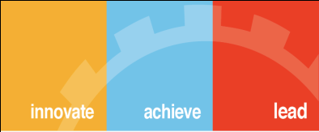
Thank You

